Slide 1
Checking understanding of multiplicative relationships
Task A: Comparing using proportion
1) By subdividing the bar models, work out what £3 is as a proportion of the whole amount.
a)
b)
c)
£30
£12
£15
2) By simplifying fractions, work out:
a) what proportion £12 is out of £40?
b) what proportion £12 is out of £15?
c) what proportion £12 is out of £12?
‹#›

Slide 2
Checking understanding of multiplicative relationships
Task A: Comparing using proportion
3) Test A is out of 20. Laura gets 12 out of 20 correct.
Test B is out of 50. Sofia gets 40 out of 50.
Who got a higher proportion of answers correct?
4) Here is a table showing pay increases in allowances.
Which pupil got the best allowance increase and why?
Pupil | Normal allowance per month | Increase | Proportion of normal allowance
Aisha | £15 | £6
Andeep | £10 | £2.50
Izzy | £12 | £4
Jacob | £30 | £6

Slide 3
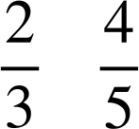
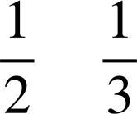
Checking understanding of multiplicative relationships
Task B: Paying attention to the whole
Insert the correct inequality =, < or > for the following:
50% of 900 10% of 4000
of 24 of 60
d)
e) of 30 of 50
f) 1% of 900 900% of 1
2) Each pupil in Oak academy has a cashless account.
All Oak pupils have been excellent and the Oak teacher can award them with either 20% more of what is in their account or £2 more what is in their account.
Which offer should each pupil receive to get the best deal?
Pupil | Account
Andeep | £4.50
Aisha | £11.29
Izzy | £9.96
Jacob | £8.90
Jun | £10
Pupil | Account
Lucas | £32
Sam | £8.23
Alex | £2.13
Sofia | £20.12
Laura | £9.99

Slide 4



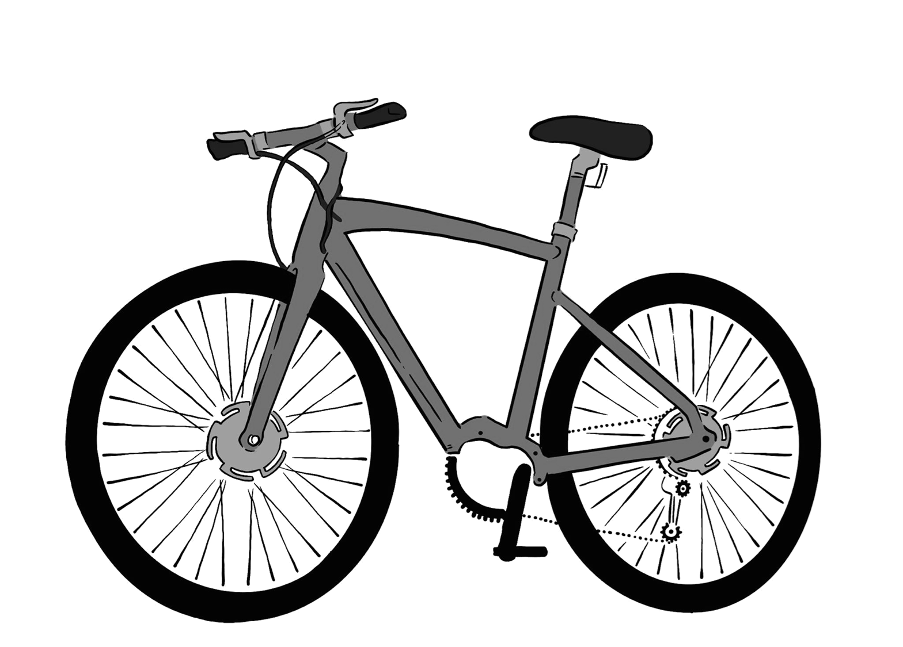
Checking understanding of multiplicative relationships
Task B: Paying attention to the whole
3) Tick which is the best offer or if there is not enough information.
Statement | A is better | B is better | Both the same | Not enough information
A is offered 10% of £100 B is offered 5% of £200
A is offered 79% B is offered 100%
A is offered of £24 B is offered of £19
A is offered 20% more money than B
4) Jacob is looking for a new bike. Two shops sell the same bike.
Shop B
Shop A
£120
£120
SALE 30% off
SALE 20% off
Plus an extra 10% off the sale price
Jacob says, “Both have 30% off in total so the bike costs the same in both shops.” Show if Jacob is correct or not.
v2.1

